Slide 1

Rental Price Classification using Machine Learning
Fundamentals of Data Analytics – CSIS 3360
Instructor: Nikhil Bharadwaj
Group Members:
Ricardo Ruiz – 300387021
Jarlath Hackman – 300399902
Demi Le – 300312139
Anushka Kshirsagar – 300395615

Slide 2

Business Objective
Objective: Classify rentals as Low, Medium, or High
Benefits:
Owners set fair prices
Renters judge affordability
Approach: ML classification model

Slide 3

Dataset Overview
Number of rows: 99,390 rows
Feature | Description
amenities | Types of amenities available in the apartment
bathrooms | Number of bathrooms in the apartment
bedrooms | Number of bedrooms
fee | Indicates if there is an additional fee
Pets | Yes/No – Indicates whether pets are allowed
price | Rental price in USD (the main numerical feature for categorization)
square_feet | The area of the apartment in square feet
cityname | The city where the apartment is located
state | The U.S. state where the apartment is located
https://archive.ics.uci.edu/dataset/555/apartment+for+rent+classified

Slide 4
Data Cleaning & Feature Selection
Remove redundant columns like currency, title, address, …
Chosen features: square_feet, bedrooms, bathrooms, fee, Pets
Transformation
Pets -> 0: no pets & 1: with pets
Scaling
Scale all numeric columns to the same range
Aggregation
Count number of amenities -> transform to numeric variables
Removal

Slide 5
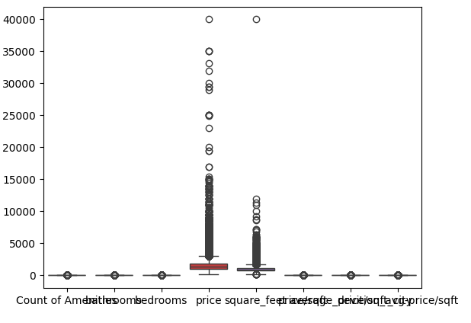
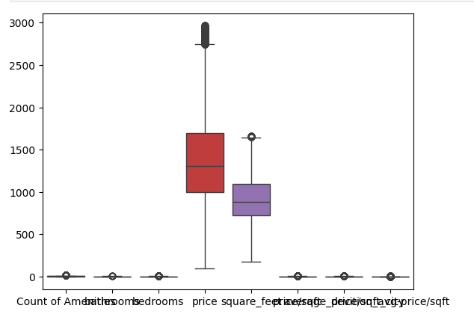

Outlier Detection
Drop all data points lie above upper bound and below lower bound
BEFORE
AFTER

Slide 6
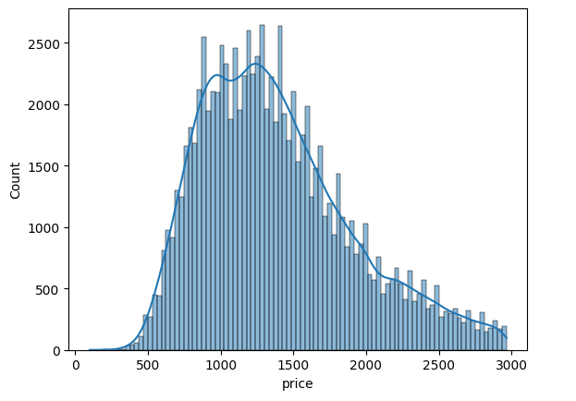
Exploratory Data Analysis: Price Distribution
Key Observation
The distribution is right-skewed (positively skewed)
The peak (mode) occurs around $1000–$1300, indicating this is the most common rental price range.
Very few listings fall below $500, suggesting a natural market floor or minimum threshold for rentals

Slide 7
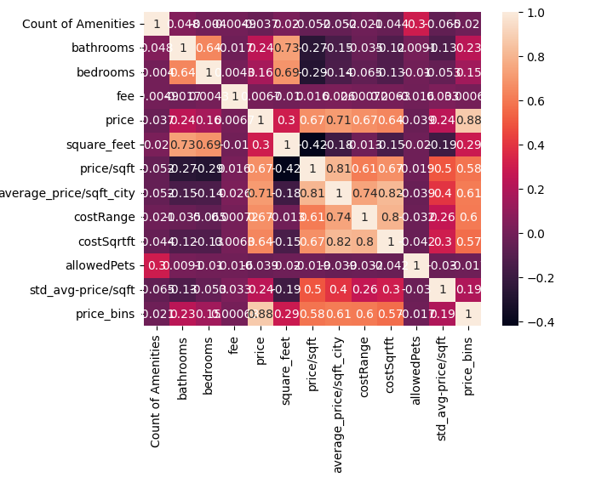
Exploratory Data Analysis: Feature Correlation
Top Predictors of price
Feature | Correlation with price | Interpretation
square_feet | 0.73 | Strongest organic feature — bigger unit = higher price
costRange | 0.67 | Engineered cost level label
average_price/sqft_city | 0.67 | Location/context-aware pricing
costSqrtft | 0.64 | Likely = square_feet × price_per_sqft (formula-driven)
bedrooms | 0.64 | Larger apartments = more rooms = more expensive
bathrooms | 0.60 | Similar to bedrooms, but slightly less predictive

Slide 8
Exploratory Data Analysis: Feature Correlation
Top Predictors of price
Feature | Correlation with price | Interpretation
square_feet | 0.73 | Strongest organic feature — bigger unit = higher price
costRange | 0.67 | Engineered cost level label
average_price/sqft_city | 0.67 | Location/context-aware pricing
costSqrtft | 0.64 | Likely = square_feet × price_per_sqft (formula-driven)
bedrooms | 0.64 | Larger apartments = more rooms = more expensive
bathrooms | 0.60 | Similar to bedrooms, but slightly less predictive
High risk of multicollinearity (Target variable is included in the formulas)
Removed!
High risk of multicollinearity (Target variable is included in the formulas)
Binning into range

Slide 9
Feature Engineering​
Feature​ | Calculation​ | Purpose​
price/sqft​ | price / square_feet​ | Normalize price across different unit sizes.​
average_price/ sqft_city​ | City-level mean of price/sqft​ | Capture geographic price variation and trends.​
deviation_avg-price/sqft​ | price/sqft - average_price/sqft_city​ | Measure how far a listing deviates from the local average.​
Cost_of_the_City | Using percentile of 33% and 66% the average_price/ sqft_city​ is divide in 3 categories | Evaluate the performance of the cities according to the general distribution of prices in the dataset.
costRange_rent​ | Binned price into 3 quantiles (25%, 75%)​ | Simplifies classification into low, medium, and high tiers.​
Notes:
To enhance our model's understanding of rental prices, we engineered several new features.
Instead of relying on raw prices, we calculated price per square foot to fairly compare units of different sizes.
We also introduced city-level averages so we can see whether a listing is priced above or below local trends.
Then, we computed the deviation from the average, helping the model recognize overpriced or undervalued units.
Finally, we created tier-based variables using quantiles to classify listings into low, medium, or high ranges —
this improves both model performance and makes results easier to interpret for users.

Slide 10
Validation Strategy​: Train/Test Split
Sufficient Dataset Size​
Dataset is large enough to ensure reliable results with a single split.​
Real-World Relevance​
Evaluates on truly unseen data, mimicking practical applications.​
Efficiency​
Saves time and computational resources, aligning with project constraints.​
Train
Test
80%
20%
Notes:
Alignment with Project Goals
Practical, interpretable, and supports real-world decision-making.
Train/Test Split: The Optimal Choice for Reliable, Real-World Accuracy."
To evaluate our models, we tested several validation strategies. While K-Fold cross-validation offers robustness and Stratified Sampling ensures class balance, we ultimately chose the classic Train/Test Split, using 80% of the data for training and 20% for testing. This choice fits our goals: the dataset is large enough to give reliable results, and this method allows us to simulate real-world scenarios where the model faces unseen data. It’s also time-efficient and interpretable, which is valuable given the time constraints and scope of the project

Slide 11

Classification
Interpreting a listing's position within the local market landscape
Notes:
In the context of our project, classification models play a key role in simplifying the decision-making process for users by categorizing rental listings into "low," "medium," or "high" price levels. Rather than predicting the exact rental cost, these models interpret a listing's position within the local market landscape—providing users with an easily digestible insight into how fair or competitive a rental price is.

Slide 12
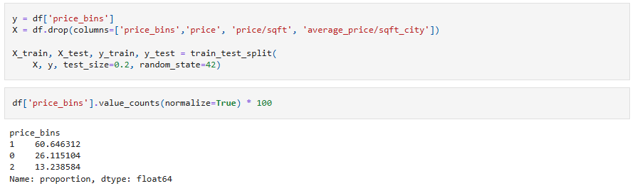
Train Test Split – Feature Selection: Code Preview
Imbalanced Class Distribution
Precision & F1-Score is better than Accuracy!

Slide 13
Implemented Algorithms​
Random Forest Classifiers​
Robustness to outliers and noise​
Handling both numerical & categorical data effectively​
High interpretability​
XGBoost
High predictive performance with imbalanced dataset​
Well-performed with complex nonlinear relationships​
Improve generalization & model accuracy​

Slide 14
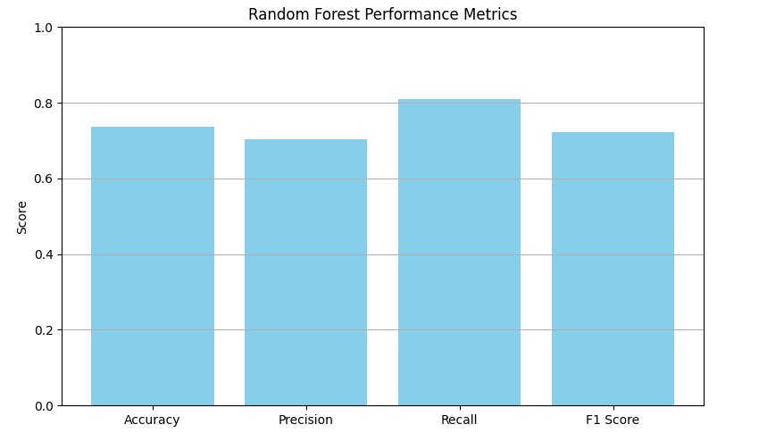
Random Forest Classifier​
Best parameters:
class_weight='balanced'
n_estimators=100
max_depth=10
Test Score:
Accuracy: 0.7376​
Precision: 0.7027​
Recall: 0.8094​
F1 Score: 0.7222​
Notes:
The Random Forest Classifier builds an ensemble of 100 decision trees, combining their predictions to improve stability and reduce overfitting. We set a maximum depth of 10 and used class_weight='balanced' to better handle class imbalances. One of its strengths is recall—at over 80%, it’s very good at identifying high-priced listings, which is useful when flagging premium rentals. Another advantage is interpretability: it tells us which features—like location or square footage—most affect pricing. While not the most accurate overall, its insights and detection power add real value to the model suite.

Slide 15
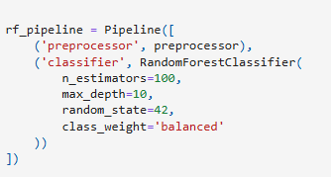
Random Forest Classifier​: Code Preview
Notes:
The Random Forest Classifier builds an ensemble of 100 decision trees, combining their predictions to improve stability and reduce overfitting. We set a maximum depth of 10 and used class_weight='balanced' to better handle class imbalances. One of its strengths is recall—at over 80%, it’s very good at identifying high-priced listings, which is useful when flagging premium rentals. Another advantage is interpretability: it tells us which features—like location or square footage—most affect pricing. While not the most accurate overall, its insights and detection power add real value to the model suite.

Slide 16
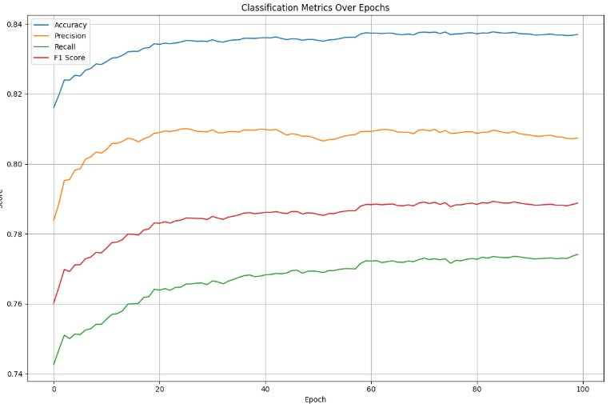
XGBoost
Best parameters:
objective= 'multi:softprob'
max_depth = 15
eval_metric= 'mlogloss'
eta=0.2
Test Score:
Accuracy: 0.7376​
Precision: 0.7027​
Recall: 0.8094​
F1 Score: 0.7222​
Notes:
The Random Forest Classifier builds an ensemble of 100 decision trees, combining their predictions to improve stability and reduce overfitting. We set a maximum depth of 10 and used class_weight='balanced' to better handle class imbalances. One of its strengths is recall—at over 80%, it’s very good at identifying high-priced listings, which is useful when flagging premium rentals. Another advantage is interpretability: it tells us which features—like location or square footage—most affect pricing. While not the most accurate overall, its insights and detection power add real value to the model suite.

Slide 17
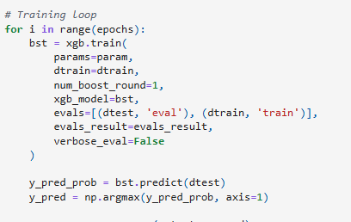
XGBoost: Code Preview
Notes:
The Random Forest Classifier builds an ensemble of 100 decision trees, combining their predictions to improve stability and reduce overfitting. We set a maximum depth of 10 and used class_weight='balanced' to better handle class imbalances. One of its strengths is recall—at over 80%, it’s very good at identifying high-priced listings, which is useful when flagging premium rentals. Another advantage is interpretability: it tells us which features—like location or square footage—most affect pricing. While not the most accurate overall, its insights and detection power add real value to the model suite.

Slide 18
Regression​
Suggest competitive pricing, forecast market trends, and optimize property listings.

Slide 19
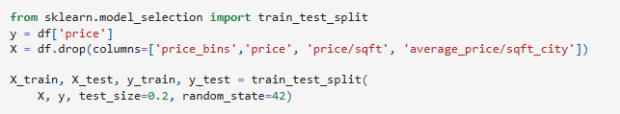
Train Test Split – Feature Selection: Code Preview

Slide 20
Training methodology​
Random Forest Regressor
Trained with max depth ranging from 1 to 20​
Evaluated using R-squared and MSE​
Linear & Polynomial Regression
Linear Regression: Baseline model (degree=1).​
Polynomial Regression: Tested degrees 1 to 4.​

Slide 21
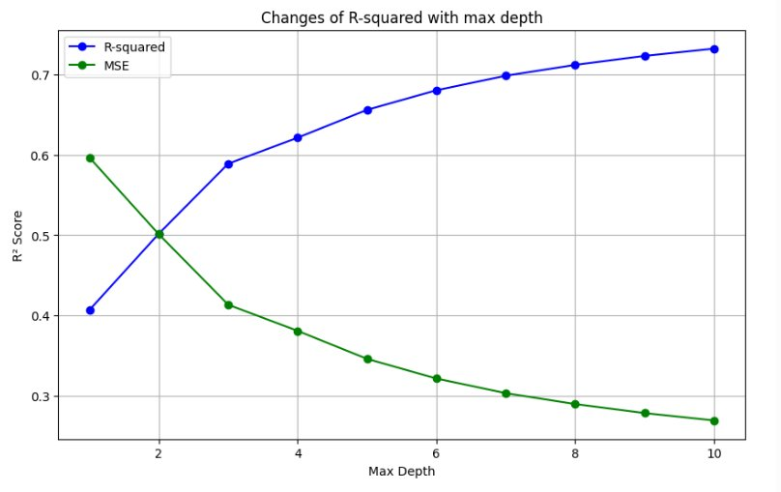
Random Forest Regressor​
Test results:
Max Depth​ | R² Score​ | MSE​
1​ | 0.45​ | 0.78​
5​ | 0.62​ | 0.61​
10​ | 0.732​ | 0.270​
20​ | 0.67​ | 0.56​
Best model:
→ max_depth = 10 → R² Score = 0.7320 → MSE = 0.2696
Key observations:
Best performance at max depth=10 (R² = 0.68).
Overfitting observed beyond depth=15 (R² plateaus).

Slide 22
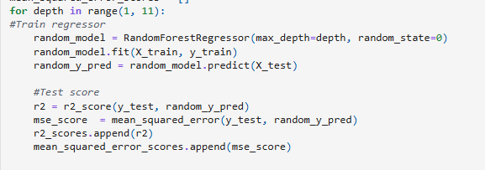
Random Forest Regressor​: Code Preview

Slide 23
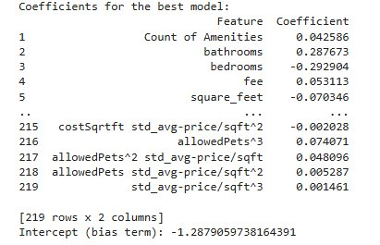
Linear/Polynomial Regression
Best model:
Degree: 3​ R² Score = 0.6837​ MSE = 0.564
Degree​ | R² Score​ | RMSE​
1​ | 0.627​ | 0.612​
2​ | 0.672​ | 0.574​
3​ | 0.684​ | 0.564​
4​ | -7.59 (Invalid)​ | 2.94​
Key observations:
Degree-3 polynomial performs best (R² = 0.684).​
Degree-4 fails due to overfitting (negative R²).

Slide 24
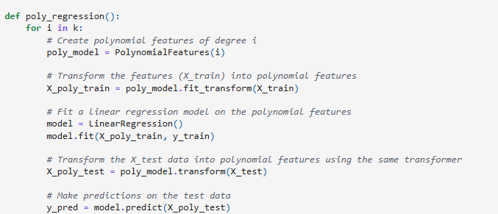
Linear/Polynomial Regression: Code Preview

Slide 25
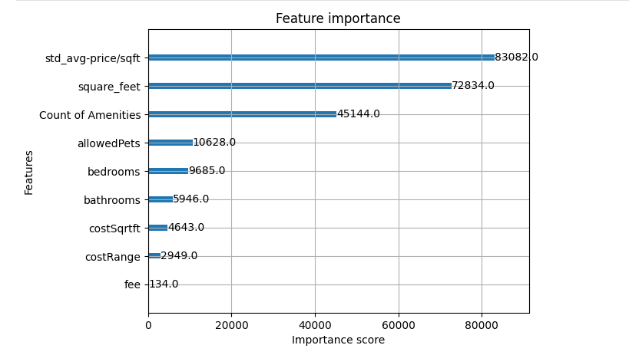
Feature Importance Score
Notes:
To enhance our model's understanding of rental prices, we engineered several new features.
Instead of relying on raw prices, we calculated price per square foot to fairly compare units of different sizes.
We also introduced city-level averages so we can see whether a listing is priced above or below local trends.
Then, we computed the deviation from the average, helping the model recognize overpriced or undervalued units.
Finally, we created tier-based variables using quantiles to classify listings into low, medium, or high ranges —
this improves both model performance and makes results easier to interpret for users.

Slide 26
Model Evaluation
Task​ | Model​ | R-squared​ | RMSE​ | Precision​ | Recall​ | F1-Score​ | Avg. Prediction Time per sample​
Regression​ | Polynomial Regression​ (degree=3)​ | 0.68​ | 0.564​ | -​ | -​ | -​ | 0.00000040s​
Regression​ | Random Forest​ | 0.732​ | 0.2696​ | -​ | -​ | -​ | 0.00000812s​
Classification​ | Random Forest​ | -​ | -​ | 0.7027​ | 0.8094​ | 0.7222​ | 0.00000822s​
Classification​ | XGBoost​ | -​ | -​ | 0.8096​ | 0.7735​ | 0.7893​ | 0.00000009s​
Notes:
To enhance our model's understanding of rental prices, we engineered several new features.
Instead of relying on raw prices, we calculated price per square foot to fairly compare units of different sizes.
We also introduced city-level averages so we can see whether a listing is priced above or below local trends.
Then, we computed the deviation from the average, helping the model recognize overpriced or undervalued units.
Finally, we created tier-based variables using quantiles to classify listings into low, medium, or high ranges —
this improves both model performance and makes results easier to interpret for users.

Slide 27
Final Model Selection​
Regression: Random Forest Regressor​
→ Best for estimating exact rental prices​ → Higher R² and lower RMSE​
Classification: XGBoost Classifier
→ Best for categorizing prices into tiers​ → Highest F1 Score & fastest inference​
Real-life Applications:
Stakeholder​ | How They Benefit​ | Recommended Model​
Property Owners​ | Set optimal pricing → higher occupancy​ | Regression (Random Forest)​
Renters​ | Quickly judge if a listing is overpriced or fair​ | Classification (XGBoost)​
Rental Platforms​ | Suggest fair price ranges, detect pricing outliers, enhance search functionality​ | Both (Regression + Classification)​

Slide 28
Thank You

